Slide 1


Road Sign Classification Using CNN
By
Kowsalya J
DADS NOVEMBER BATCH

Slide 2


Objective:
Develop a Convolutional Neural Network (CNN) to recognize and classify road signs into 30 distinct categories.
Enhance road safety and support autonomous driving by accurately detecting and interpreting traffic signs
Methodology:
Collected and preprocessed labeled road sign images.
Built and fine-tuned a deep learning model with techniques like image preprocessing, augmentation, and hyperparameter tuning.
Created an interactive web application using Streamlit for demonstration and testing purposes.

Slide 3



PROBLEM STATEMENT
🚗 Importance of Recognition
Traffic signs play a crucial role in ensuring road safety and guiding autonomous vehicle navigation.
⏱️ Challenges with Manual Methods
Classifying signs manually is error-prone and inefficient, making it unsuitable for deployment in large-scale or real-time systems.
🤖 Deep Learning Automation
Objective: Leverage Convolutional Neural Networks (CNNs) to automate traffic sign recognition, enhancing accuracy, speed, and scalability.

Slide 4


Data Preprocessing
Resize Images
Consistent image dimensions (e.g., 64x64x3)
Normalize Pixels
Pixel values between 0 and 1
Split Dataset
Defined distribution for training, validation and testing
Encode Labels
Integers or one-hot vectors

Slide 5




Rotation
Scaling
Flipping
Cropping
Data augmentation enhances dataset diversity and improves model robustness, enabling the model to generalize more effectively to unseen data variations.

Slide 6
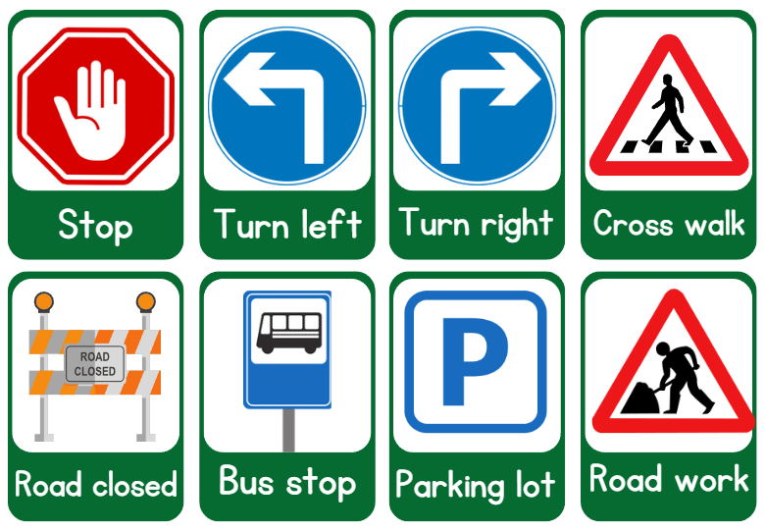
Conclusion
Key Achievements
Successfully built a lightweight and accurate model, complemented by an intuitive user interface.
Future Enhancements
Plan to retrain using real-world datasets and incorporate the model into simulation environments.
Deployment Strategy
Apply quantization techniques to ensure efficient deployment on mobile devices.

Slide 7


THANK
YOU

